Slide 1
2020 Census Enterprise Architecture and Infrastructure Transition Plan (CEAITP): Technical Architecture View
Junxiang Wang
May 1st, 2017

Slide 2
1. Service Oriented Architecture 2. Quality Measurements 3. Current Architecture VS Target Architecture

Slide 3
Service Oriented Architecture(1)
Service Oriented Architecture (SOA)
Aim to
Decrease architecture complexity and increases the application integration more efficiently.
Provide the data and application APIs to systems, which are accessible throughout the enterprise.
Deliver applications faster with lower system integration costs.
Provide support for application services reuse and enable business functions to operate more efficiently.

Slide 4
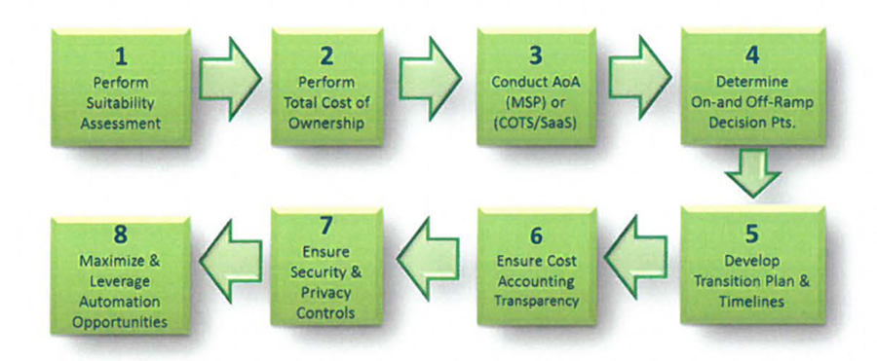
Service Oriented Architecture(2)
Enterprise Cloud
Figure 1.Key Strategic Steps for Consideration to Enterprise Cloud

Slide 5
Service Oriented Architecture(3)
Perform suitability assessment on technology/architecture to determine readiness or potential for a cloud solution.
Perform a Total Cost of Ownership (TCO) including an AoA to see if a commercial managed service provider (MSP) or COTS/Saas is more appropriate to deliver the capability.
Determine appropriate on-ramp and off-ramp, either in a tech refresh, or a move to a different cloud service provider (CSP), while considering alignment with other technologies that have dependencies or a specific application is dependent on.
Ensure appropriate security and privacy controls including records retention can be achieved with the solution.
Ensure cost accounting and transparency can be achieved with the solution. Consider what to purchase, how to monitor and control costs, and ensure appropriate levels of service(s) are provided for payments made.
Develop transition plan and schedule to include a WBS that aligns resources to the various activities.
Maximize and leverage automation opportunities- It is important to recognize possible areas and opportunities to automate and optimize technical and business operations.

Slide 6
Quality Measurements(1)
Program-Enterprise-System Quality
four categories of quality
Business/Program quality - Ensures governance processes, timelines, and milestones are realistic.
Enterprise quality - Ensures enterprise level services, integrations, and tools operate as designed and intended.
Data Quality- Ensures the overall Census Count is accurate.
System Quality - Ensures higher-quality data capture via entry by human or machine (e.g. scanning solution), or via interfacing with other internal and external systems.

Slide 7
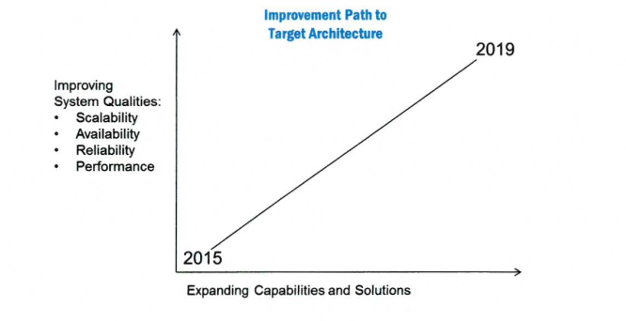
Quality Measurements(2)
Figure 2.Quality Aspects vs. Expanding Capabilities and Solutions

Slide 8
Quality Measurements(3)
Scalability & Performance
Scalability refers to the ability of a system, network, or process to adapt and handle change in workload capacity and process demands.
The scale-up initiative is underway led by a three stage model, the conceptual, analysis, and implement/test.
The conceptualize stage starts the process by producing several artifacts. They are the demand models, and the Non-functional requirements.
The analysis stage realizes the overall solution, system, data flow, and interfaces.
The Implement/test focuses on execution and testing of the analyzed models, using optimization, partitioning, replication, design, patterns, scaling and continuous testing techniques.

Slide 9
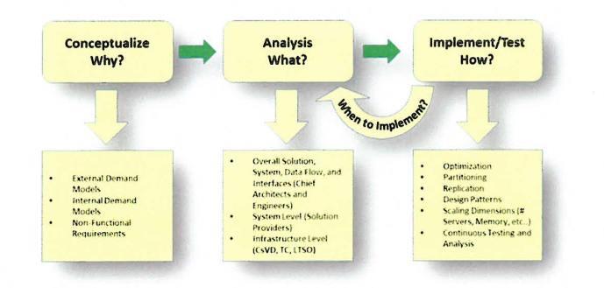
Quality Measurements(4)
Figure 3.2020 Scale-Up Three Stage Process

Slide 10
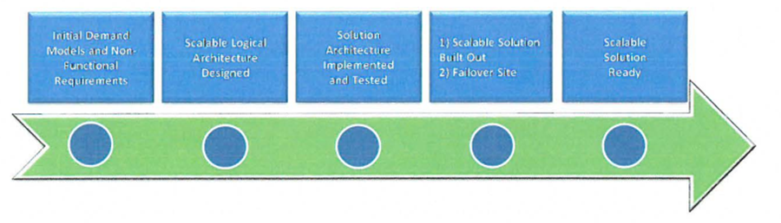
Quality Measurements(5)
Figure 4. Scale-up Initiative Transition Timeline

Slide 11
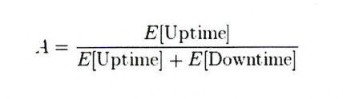
Quality Measurements(6)
Availability & Reliability
A system is considered reliable when it continues to operate as designed.
Availability is the probability that a system will work as required for the duration of its mission.
Figure 5. The definition of availability

Slide 12
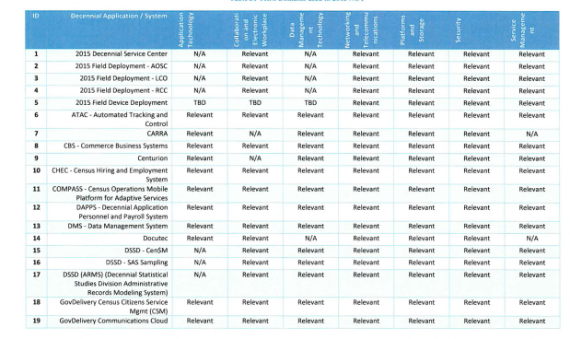
Current Architecture VS Target Architecture(1)
Infrastructure Architecture(Technical Reference Model)

Slide 13
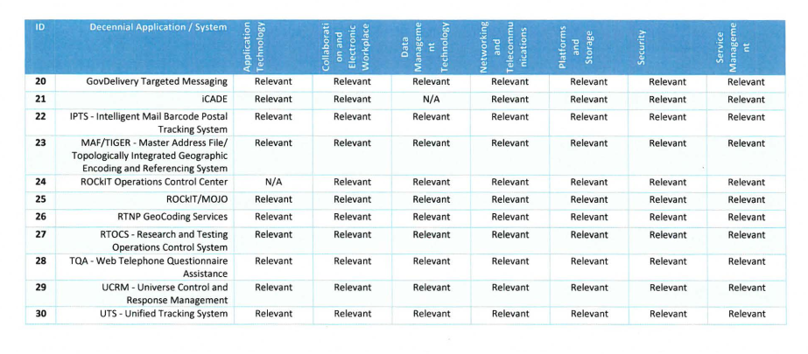
Current Architecture VS Target Architecture(2)
Figure 9. Technical reference model for the current infrastructure architecture

Slide 14
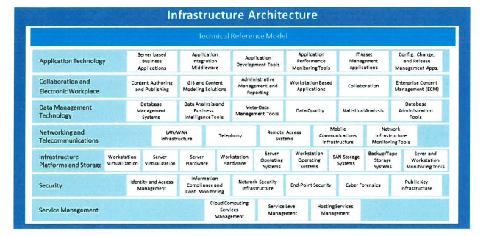
Current Architecture VS Target Architecture(3)
Figure 10. Technical reference model for the target infrastructure architecture

Slide 15
Current Architecture VS Target Architecture(4)
Security Architecture
Table 3. Standards and rules comparison
 | Current | Target
Standards and rules | Federal Information Security Management Act (FISMA) , the National Institute of Standards and Technology (NIST) ,Title 13 and Title 5 | Federal Information Security Management Act (FISMA) , the National Institute of Standards and Technology (NIST) , The Census Bureau Risk Management Framework (RMF),

Slide 16
Current Architecture VS Target Architecture(5)
Quality Architecture
Table 4. goal comparison
 | Current | Target
Goal | Coverage measurement was not a major focus while data quality is . | The primary goal of the 2020 Census is to collect complete, accurate, and quality Census data

Slide 17
Thank you.
Any questions?

